Slide 1

College Presentation
galileoweb.org/college/
Download this presentation on the above website
An Overview of the College Application Process for 2012 Seniors
BAI ZHEN, UC Berkeley
EMAIL: zhenb@galileoweb.org
(415) 749 3430 x3246
Monday-Thursday 9:30-6 PM

Slide 2

You

Slide 3
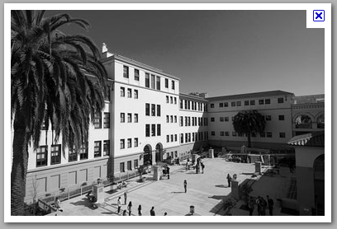
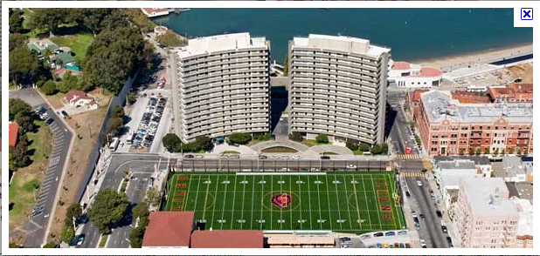

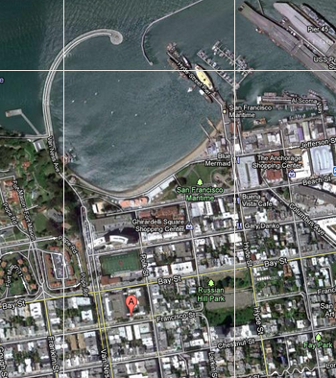

Slide 4
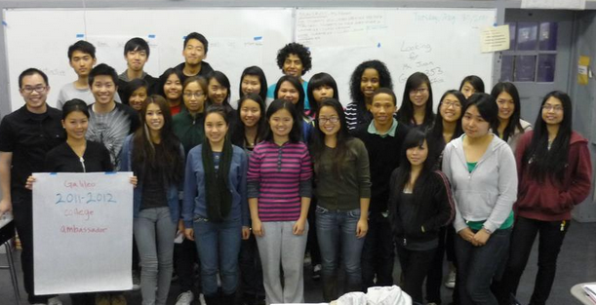

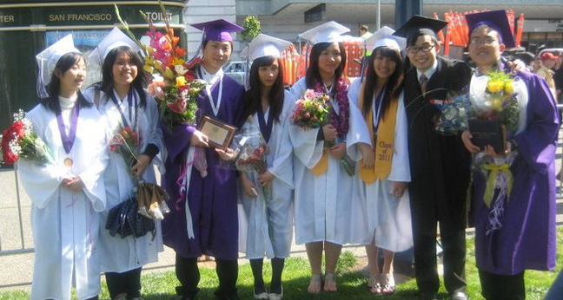
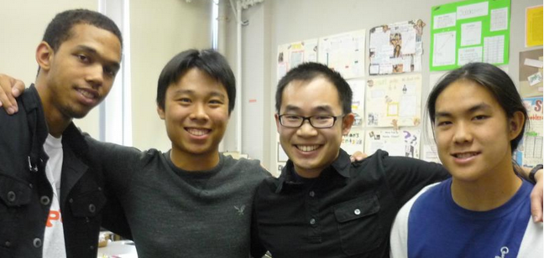
College Ambassadors
Helping Bai share college information with Galileo students.

Slide 5
Summary of Deadlines:
COLLEGE SYSTEM | Application Available | Application Deadline | Websites:
University of California | Oct. 1 | Wed, NOV. 30 | universityofcalifornia.edu
California State University | Oct. 1 | Wed, NOV. 30 | csumentor.edu
Private | LIVE! Now ☺ | Varies: Dec/Jan | commonapp.org
Community College | Around Feb/March 2012 | Submit ASAP | cccapply.org

Slide 6
College Presentations
AFTER-SCHOOL in the Counseling office, 258F
Wed, Sept. 28 at 2 pm: San Francisco State University
Mon, Oct. 17 at 3 pm: Smith College
Thurs, Oct. 20 at 3 pm: USC & Whitman College
Mon, Oct. 24 at 3 pm: Amherst College
Tues, Oct. 25 at 3 pm: Dominican University of CA
Tues, Nov. 1 at 3 pm: UCLA
Thurs, Nov. 3 at 2 pm: CSU Sacramento
Wed, Nov. 9 at 2 pm: Cal Poly Pomona
College & Career Expo: College Fair: 60+ colleges
Friday, Oct. 14, from 9:30-11:30 a.m.
Including: UC, CSU, Private colleges, for a complete list of colleges, go here: galileoweb.org/college
UC Davis college campus field trip: Wed, Oct. 19

Slide 7

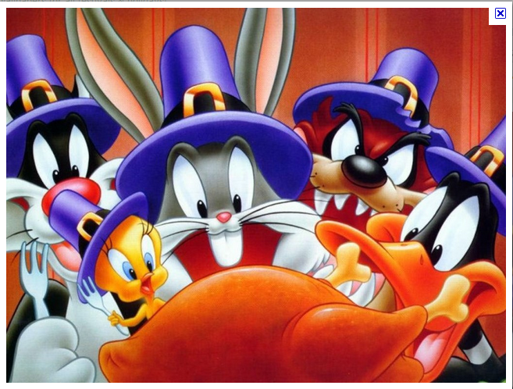
College Workshops, Rm 104
Tentative Dates, After-school in Computer Lab 104
Wednesday, Oct. 26
Thursday, Oct. 27
Wednesday, Nov. 2
Thursday, Nov. 10
Wednesday, Nov. 16
Thursday, Nov. 17
Monday, Nov. 21
Tuesday, Nov. 22
Monday, Nov. 28
Tuesday, Nov. 29
DEADLINE for UC/CSU on November 30.
Aim to finish applications before Nov. 22!

Slide 8
Important Tips
Apply broadly!
Remember your username & passwords
Check your e-mail & college-portal sites
Senior year grades still very important.
No D/F, make sure to keep up grades!

Slide 9

Financial-Aid & Scholarship
A College Education is Affordable with Financial-Aid!!!!
FAFSA: Free Application for Federal Student Aid
Apply starting January 1, Deadline: MARCH 2
http://www.fafsa.gov/
CSS Profile (private colleges)
profileonline.collegeboard.com/
SCHOLARSHIPS:
Galileoweb.org/college/scholarships
Family Income
# of Family Household
# Assets

Slide 10
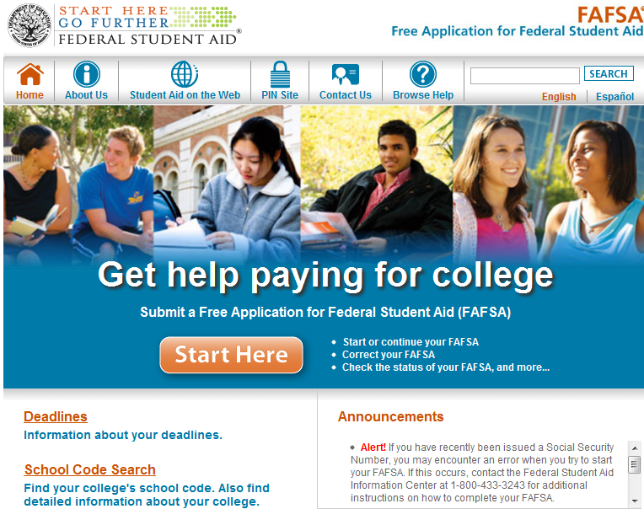
Free application for Federal Student Aid: Fafsa.gov

Slide 11
Fee-Waivers: College Apps
4 fee-waivers for CSU
Apply online: only 1 chance to apply.
4 fee-waivers for UC
Apply online: when submitting the application
4 fee-waivers for Private Colleges
College-board fee-waiver: ask me for it.
Community College application: No FEE

Slide 12
College Fair Tips
Before the fair, Research the colleges & ask yourself:
Answer the following questions to help you determine what kind of school would best suit you:
Do you want to attend a two- or four-year institution? Co-ed or single sex?
What size school do you want to attend?
What programs of study are you considering?
How far from home do you want to go?
Do you wish to participate in any extra-curricular activities or athletics?
Do you want to attend a school in an urban, suburban or rural place?
Do you require any special services (i.e. tutoring, note takers, readers, TDD or interpreters)?
Discuss your college plans with your counselor, family, teachers and friends.
Research your colleges of interest on the Internet
At the Fair...
1. Visit colleges and universities which you feel meet your criteria.
2. Talk with a college counselor. Introduce yourself, ask questions.
3. Get college representative contact information for follow-up.

Slide 13
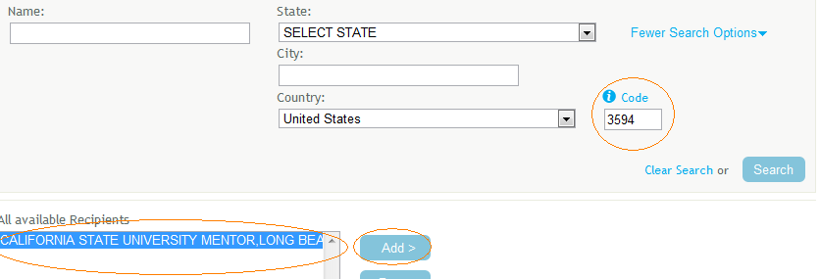
Sending SAT/ACT Scores
Download guide: galileoweb.org/college/resources/satact/
QUICK GUIDE to SEND SAT scores:
Tips: Send most recent SAT scores, they’ll send all scores.
CSU: 3594 under “More Search options”
CSU Mentor Long Beach
UC: Send one, all will get it
Private: Need to send to all of them.
QUICK GUIDE to SEND ACT scores:
CSU: Send to one, use ACT Score Manager to release scores to other CSU
UC: Send one, all will get it
Private: Need to send to all of them.
TIP: Send scores by specific deadline to take advantage of FREE sending scores.
Example: GPA: 4.8 SAT/ACT: 2400/36 President of 10 clubs, Captain of several sports. Should he still send scores to UC/CSU/ Privates?
YES!!

Slide 14

CSU: ELM/EPT exams
SIGN UP HERE to take exam at SFSU: http://www.sfsu.edu/~testing/eptelm.html
Entry-Level Math (ELM)/English-Placement Tests (EPT): You need to take the exams early, otherwise you won’t be able to sign-up for classes at CSU
Preparation: csusuccess.org
Early start:
Required for students who do not meet the ELM/EPT proficiency requirements
Program starts the summer before freshman yr.
Will be available at CSU-campus, community college & online.
Financial-aid available for those who demonstrate need

Slide 15
EOP: Educational Opportunity Program
www.csumentor.edu/planning/eop/ Deadline varies: Jan. 31
Designed to improve access and retention of historically low-income and educationally disadvantaged students.
EOP students have the potential and demonstrated motivation to perform satisfactorily at a CSU, but they have not been able to realize their potential because of their economic or educational background.
The program provides admission and academic assistance to EOP students.
In many cases, the program offers financial assistance to eligible students.
IMPORTANT INFORMATION REGARDING APPLYING FOR EOP: In order to begin an EOP application, you must first submit an online undergraduate application to the campus to which you are applying. EOP application requires two letter of recommendations

Slide 16
Letter of Recommendation
galileoweb.org/college/letter/ Bai deadline: Wed, Nov. 30th
SPECIFIC TIPS FOR RECOMMENDATIONS
Typically, you’ll need two from teachers, one from counselor:
1. Put together a packet. Include: transcript, your resume, personal statement, envelopes, deadlines.
2. Ask if they feel they can write a good recommendation. Ask teachers known you well, in core academic subject.
3. Give your teacher plenty of time. At least four weeks. The more time you can give your teacher the better.
4. After you ask for a recommendation, check back regularly with your teacher. After the recommendations go out, as a courtesy, keep your teacher/counselor updated about how your college application process.
5. Lastly, show gratitude! ☺

Slide 17
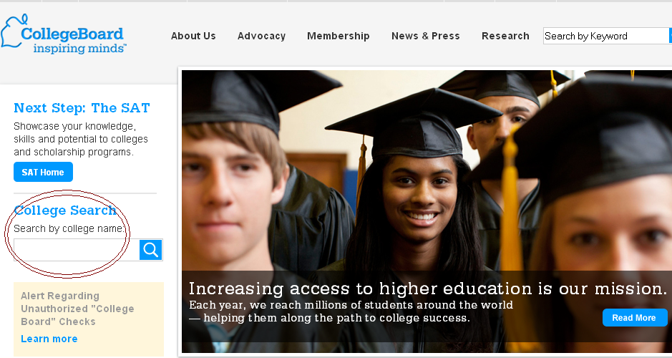
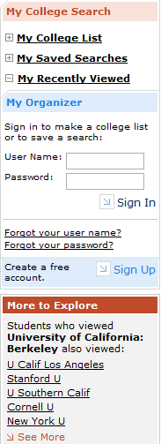
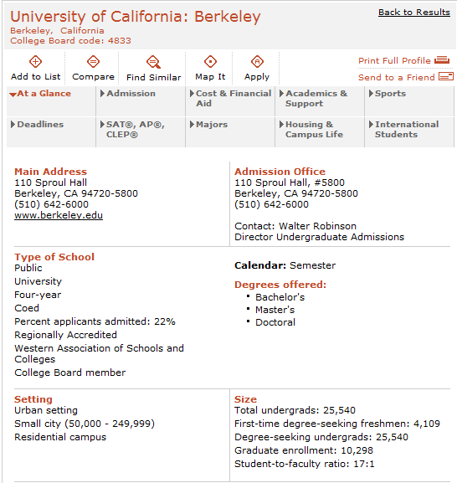
How to Choose a College?
http://www.collegeboard.org/
Factors to Consider:
Parental desire, friends
* Majors, Curriculum
Ideal Environment, Size
* Distance from Home, Location, Costs
What’s Important to You
Where you feel happy ☺

Slide 18

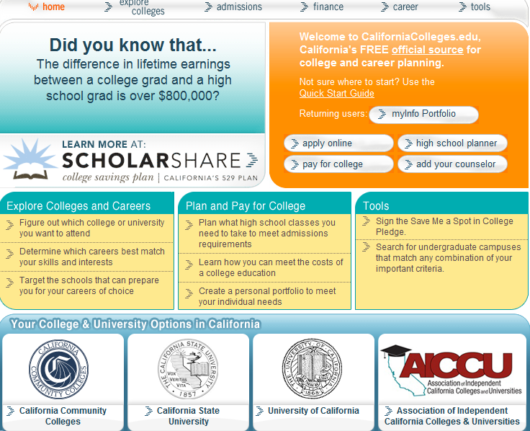
California Colleges

Slide 19
Pathways To California Higher Education
Doctorate/
Professional
Degree
Doctorate/
Professional
Degree
Graduate/
Professional
Schools
BA/BS Degrees
Awarded to
CCC Transfers:
Master’s
Degree
Master’s
Degree
Master’s
Degree
55-60% CSU
28-30% UC
20% Private
Senior
Bachelor’s
Degree
Bachelor’s
Degree
Bachelor’s
Degree
Upper
Division
Coursework
Admission Priority
to CCC Transfers
Admission Priority
to CCC Transfers
California Independent Colleges & Universities
Actively Recruit Transfer Students
Junior
Transfer Requirements:
GPA/Major/GE
Sophomore
Transfer/
Associate’s Degree
Lower
Division
Coursework
Freshman
Certificate
California Community
Colleges
(110 campuses)
California State
University
(23 campuses)
University of
California
(9 campuses)
California Independent Colleges
& Universities
(77+ campuses)
Recommended:
SAT For Athletes
SAT/GPA
SAT/GPA
SAT/GPA
High School Graduate
www.collegeofsanmateo.edu/transfer

Slide 20
Segments of Higher Education
77+ Independent/Private Universities
10 University of California
23 California State Universities -
112 California Community Colleges
Which segment in California enrolls the majority of students in undergraduate education?
California Community Colleges

Slide 21
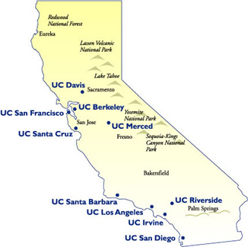
University of California
* University of California (UC)- 加 州 大 學
10 間學院:
UC Berkeley, UC Davis, UC Santa Cruz,
UC Merced, UC Santa Barbara
UC Irvine, UC Los Angeles,
UC Riverside, UC San Diego.
Graduate School: UC San Francisco (醫學院),

Slide 22

Universityofcalifornia.edu/admissions/

Slide 23
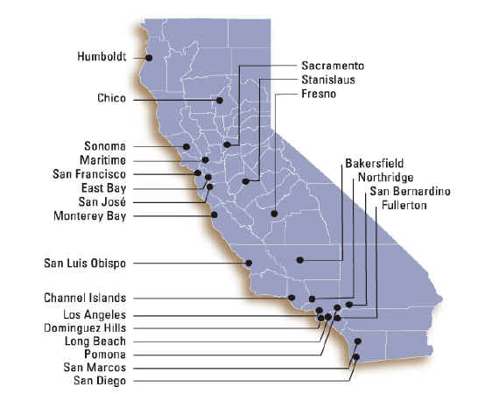
California State University
California State University (CSU)-加州州大學
23 間學院: San Francisco State University (local),
Non-Impacted: Monterey Bay, East Bay, Maritime, Stanislaus, Channel Islands, Dominguez Hills, Bakersfield
Impacted: San Jose, Sonoma, San Diego, Sacramento, Fresno, Chico, Humboldt, Northridge, Dominguez Hills, Pomona, San Marcos, LA
Impacted in all Majors: Long Beach, San Luis Obispo, and Fullerton

Slide 24
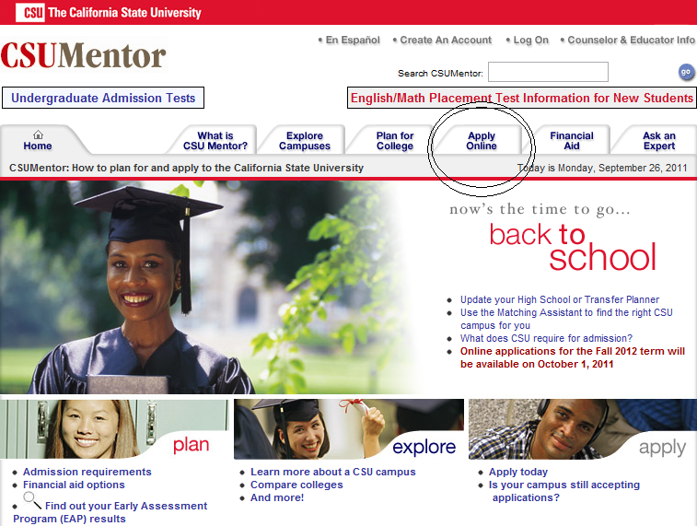
csumentor.edu

Slide 25
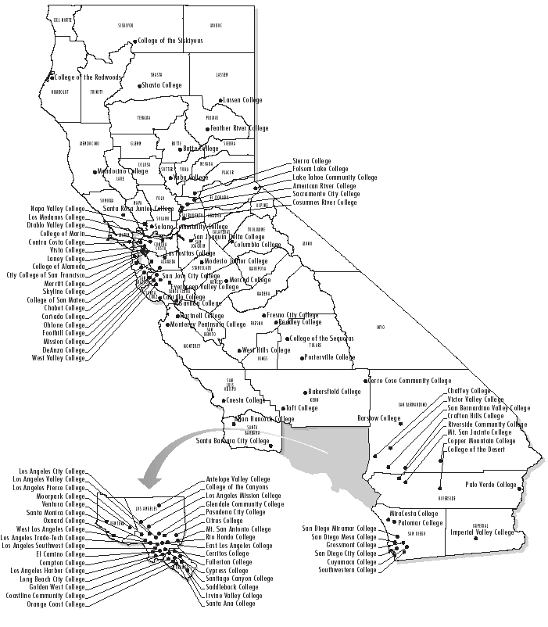
Community Colleges
112 colleges: City College of San Francisco (CCSF), Skyline, College of San Mateo, Laney College, etc.

Slide 26


Slide 27
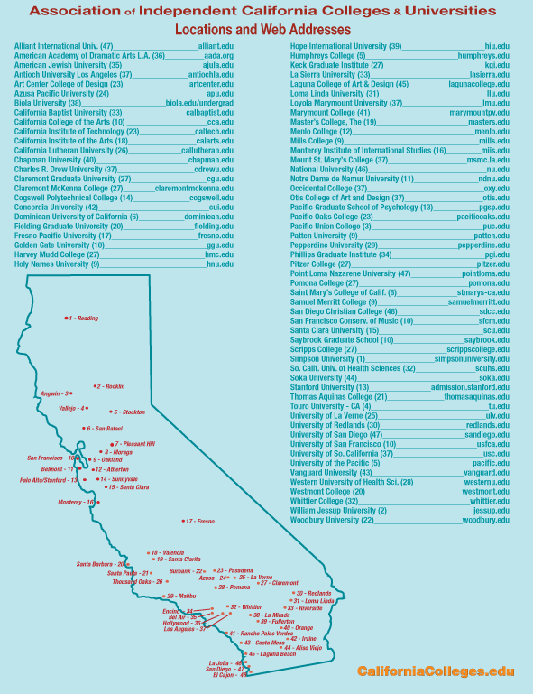
CA Private Colleges
75+ colleges: Stanford, University of San Francisco, University of Southern California, St. Mary, University of the Pacific, Dominican University of California, Mills College, Chapman,
And hundreds of private colleges outside of California:
Haverford, Harvard, Whitman, Mt. Holyoke, Smith, New York University, Amherst, Dartmouth, Knox, Whitman, Wesleyan, and many more!

Slide 28
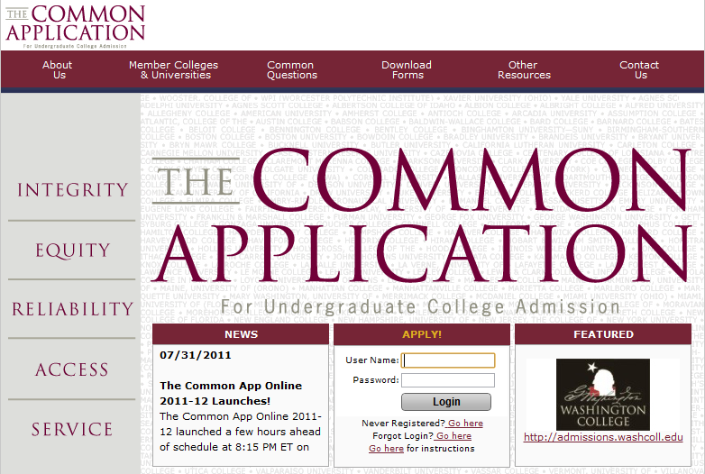
456 private colleges

Slide 29
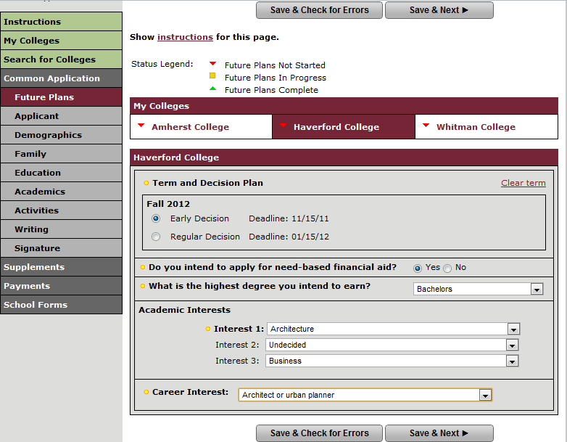
Early Decision, Action vs. Regular
Early Decision:
Binding (early deadlines)
Early-Action:
Non-Binding (early deadlines)
Regular Decision:
Normal Deadline, not binding

Slide 30
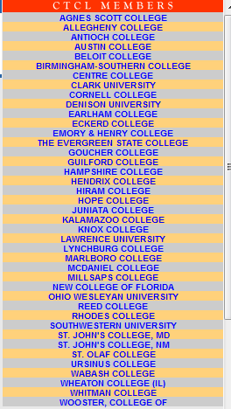

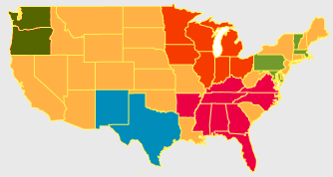
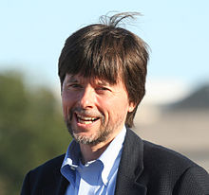

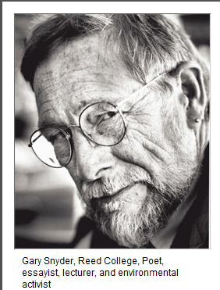

STUDENT-CENTERED: Develops lifelong love of learning and provides the foundation for a successful and fulfilling life beyond college.
Does It Matter Where You Go to College?
What You Do vs. Where You Go
http://www.ctcl.org/files/pdfs/does-it-matter-NYTimes113010.pdf
Ken Burns, director
Hampshire College
The key to success in college and beyond has more to do with what students do with their time during college than where they choose to attend.

Slide 31
UC/CSU/Private ADMISSIONS REQUIREMENTS
Subject Requirements--科 目 條 件
Test Requirements--入 學 考 試 條 件
GPA--科目平均數
Personal Statement-- 個人論文 (UC only)
Letter of Recommendations: (Private only)

Slide 32
Subject Requirements
Complete “a-g” subjects
a) 2 years of history/social studies
b) 4 years of English
c) 3 years of math
d) 2 years of lab science (one physical science & one biological)
e) 2 years of a language other than English: Chinese, Spanish, French
f) 1 year of a Visual or Performing Art course
g) 1 additional college prep elective course that falls within the a-f subjects

Slide 33
TEST REQUIREMENTS
 | SAT I | ACT w/ Writing (需要作文部分) | ACT (不需要作文部分) | SAT II: Subject Tests
UC (加大) | X | X |  | Optional
CSU (州 大) | X |  | X
CC (社區大學)
Private (私立) | X | Depends on the college

Slide 34
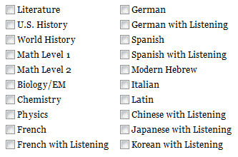
SAT II Subjects
Some campuses may recommend SAT Subject Tests for specific majors: Highly recommended for Engineering & Science Majors
http://www.universityofcalifornia.edu/admissions/freshman/requirements/examination-requirement/SAT-subject-tests/

Slide 35
SAT vs. ACT
SAT I (Reasoning Test) | ACT
Writing--作文 | Writing--作文
Verbal--英文 | Verbal--英文
Math--數學 | Math--數學
 | Science Reasoning 科學推理
 | Reading--閱讀
ACT: No penalty for wrong answers
SAT: Take away a ¼ of a point for wrong answers.

Slide 36

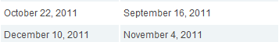
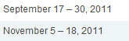

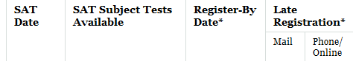
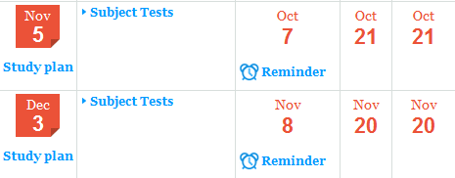
SAT, ACT Test Dates
ACT website: actstudent.org
SAT website: Collegeboard.org
FREE SAT/ACT Practice (Online Resources): http://www.blinetestprep.com/sat/ for only SAT (practice exams, interactive-guide) http://www.number2.com/ for both ACT/SAT www.perfect800.com for SAT Math, keeps track, study like a game! :) http://www.snapwiz.com/galileo interactive study tools
http://sat.collegeboard.org/practice official SAT prep exam:

Slide 37

CSUMENTOR.ORG

Slide 38
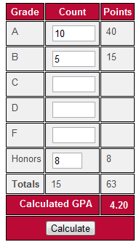
Calculating UC & CSU GPA
Use 10th grade and 11th grade classes
Count the semesters of honors/AP
A-G Course list: doorways.ucop.edu/list/
CSU Eligibility Index:
GPA | ACT | SAT I
2.9 | 10 | 510
2.55 | 19 | 860
2. 0 | 30 | 1300

Slide 39
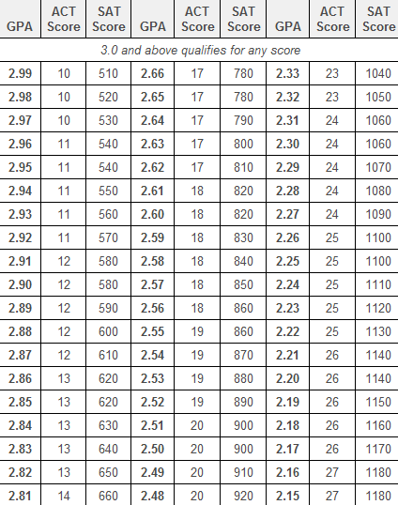
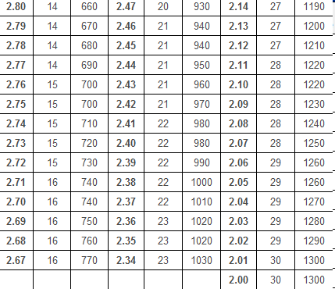
CSU Eligibility Table
Below 2.0 does not qualify for regular admission
CSU uses only SAT scores for math and critical reading
http://www.csumentor.edu/planning/high_school/cal_residents.asp

Slide 40
UC Selection Process
Grade Point Average
3.0 for California Residents
Coursework
Complete any 11 UC-approved “a-g” courses prior to senior year
Complete all 15-course “a-g” subject pattern by the end of senior year
Courses must be completed with a grade of C or better
CA Residents:
Students who meet the general path requirements AND additional criteria will be identified in one (or both) of two groups:
Statewide path
Top 9% statewide using UC’s admissions index
Local path (ELC)
Top 9% of their high school class as determined by UC

Slide 41
Reviewed vs. Selection
Requirements = Meeting requirements for freshman admission
All students who meet the requirements will be reviewed.
Selection = Choosing students for admission when a campus cannot admit all applicants who meet the freshman admissions requirements
Individual campus selection practices vary, but all draw from the same Comprehensive Review factors.

Slide 42
Comprehensive Review
14 academic and personal factors including:
Grades and test scores and:
Quality of senior year program
Special talents, achievements & awards
Promise for leadership
Recent, marked improvement in academic performance
Significant community service
Participation in student government
Intensive study and exploration of other cultures
Participation in programs like AACE Talent Search (TRIO)
Full list of factors:
www.universityofcalifornia.edu/admissions/freshman/how-applications-reviewed/
This allows UC to go beyond grades and test scores and review each applicant fully based on everything in their application.

Slide 43
Personal Statement
An opportunity for applicants to provide information that supports and enhances review process
Adds clarity, richness and meaning to application and completes the application
Enables applicant to make the best possible case for admission
An admission decision is never based on the content of the personal statement alone

Slide 44
Personal Statement Prompt
Applicants are asked to respond to two prompts:
Describe the world you come from—for example, your family, community or school—and tell us how your world has shaped your dreams and aspirations.
Tell us about a personal quality, talent, accomplishment, contribution or experience that is important to you. What about this quality or accomplishment makes you proud and how does it relate to the person you are?
Word Count: 1,000 words total

Slide 45
Additional Comments Section
Use Additional Comments box for clarification and expansion of important details.
Describe anything else that you have not had the opportunity to include elsewhere in your application.
Limit of 550 words
The Additional Comments section is not required.

Slide 46
What are the rules on repeating courses?
A course in which a D/F is earned can be repeated with a course that has the same curriculum
If a C or better is earned, the original D/F will not be included in the GPA calculation. Only the new grade will be used in the GPA calculation.
A course in which a grade of C was earned cannot be repeated.
There is no limit to the overall number of repeated courses an applicant may present, but each course can be repeated only once.
Students must list all courses, including the original course, on their application.

Slide 47
Community College
A wonderful open door of opportunity for all students
Open Access
Hundreds of programs & majors
Low-cost: $36/unit
Guaranteed Transfer Programs (TAG)
Support Services
Welcomes ALL students!
No SAT or GPA requirements

Slide 48


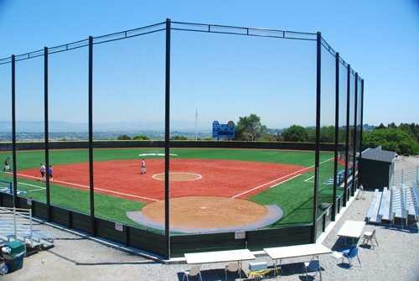
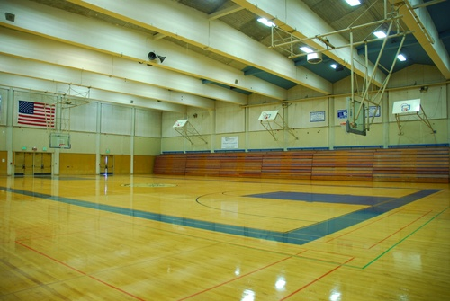
Students choose Community College …Transfer
To transfer: complete the equivalent to the universities freshmen and sophomore years at a local community college, so they can transfer as a junior to a university to complete the remaining junior and senior years to finish their bachelor’s degree
Save two years of admission & housing costs
Discover their major
Take advantage of intercollegiate athletics or foreign studies program

Slide 49











Transfer
Benefits:
Complete the same course requirements as freshmen and sophomores at a university
Receive upper division priority admission at all CSU & UC campuses
Receive higher admission rates than most freshman applicants at CSU & UC campuses

Slide 50
Strong Priority is Given to Transfers from the California Community Colleges

Slide 51
UC Student Retention & Graduation Rates
 | Freshmen | CCC Transfers
One-Year UC Persistence Rate | 92.4% | 92.2%
Elapsed Years to Degree | 4.2 | 2.4

Slide 52
Admission Criteria for Transferring Juniors
To enter all UC’s, CSU’s,
and most private universities
Community College GPA, not High School GPA
No ACT, SAT, or even an “Eligibility Index”
Community College course work – Both general education & major requirements
assist.org – Online Students Transfer Information System

Slide 53
The Importance of Major Preparation
Unlike freshmen, transfers enter halfway into a college degree
Therefore, CSU’s & UC ‘s are looking not only for general education classes, but also for significant work within the major
In many cases, the completion of lower division major preparation should be a higher priority than General Education or the Intersegmental General Education Transfer Curriculum (IGETC)
All CCC have transfer centers, where students can find out:
Information about transfer including … guaranteed transfer agreements with UC, CSU, and Private Universities
uctransfer.universityofcalifornia.edu/tag
cccco.edu – California Community College Chancellors Office

Slide 54
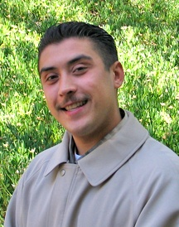
HUGO MORA
“Thank you for your passion and for your belief in me.”
EOPS Student
Latinos Unidos Club Leader
Study Abroad-Madrid, Spain
Transfer Admission Guarantee-UCSC
UCSC Pister Scholarship-$20,000

Slide 55
Students choose community college … specialized training
To receive specialized training or pursue a technical trade
Earn a certificate or an associate degree
Go directly into the world of work

Slide 56
Career Opportunities
Bio-technician
Business Manager
Computer Aided Drafter
Computer Support Specialist
Cosmetician
Dental Assistant
Hygienist
Interior Designer
Journalist
Medical Assistant
Nurse
Paralegal
Paramedic
Digital Imager
Drug Prevention Educator
Emergency Medical Technician
Fashion designer
Fire Fighter
Graphic Artist
Auto Mechanic
Police Officer
Real Estate Agent
Respiratory Technician
Surgical Technician
Telecommunication Technician
Web Designer

Slide 57

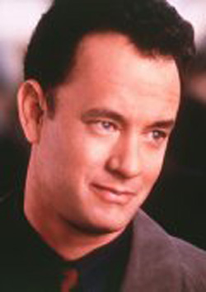
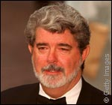

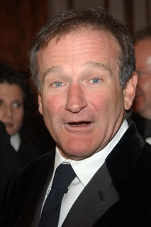
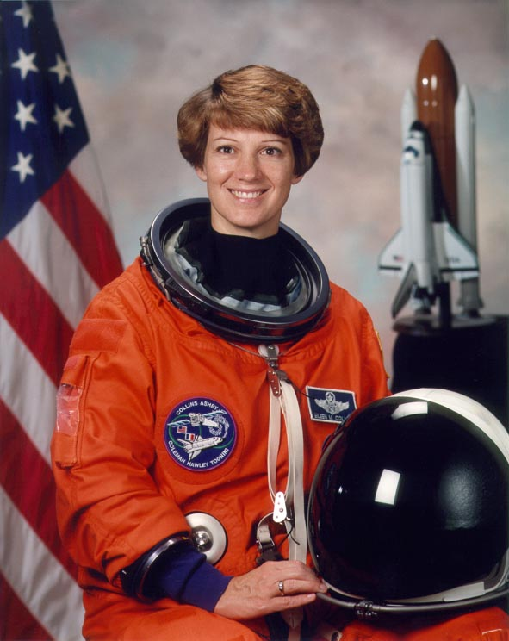
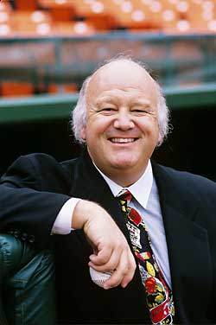
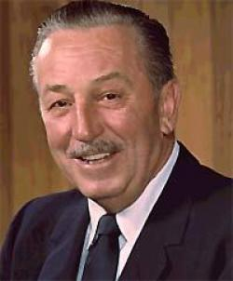
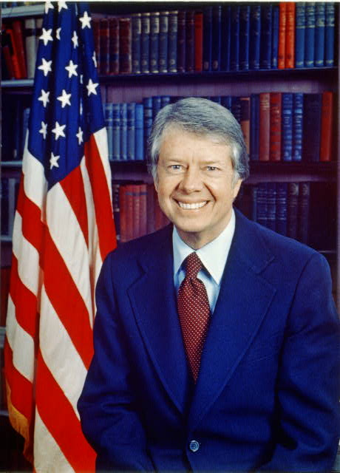
Who enrolls in Community College?
Tom Hanks
George Lucas
John Madden
Robin Williams
Eileen Collins
Walt Disney
Jimmy Carter
Jon Miller

Slide 58
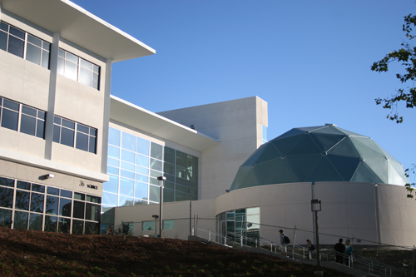
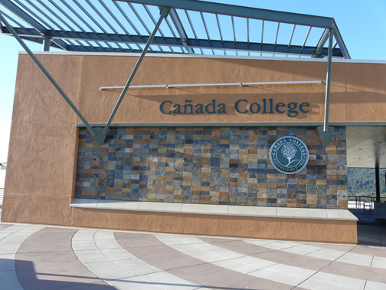
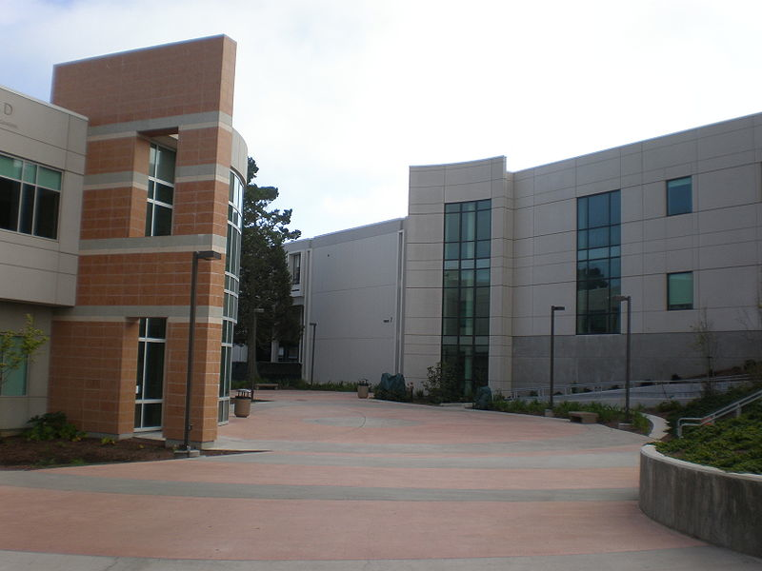
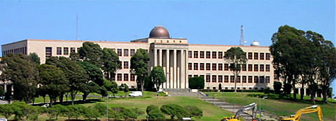
College of San Mateo
Canada College
Skyline College
CITY COLLEGE OF SAN FRANCISCO

Slide 59
The Admission Process
Application for admission - Top 100%
http://cccapply.org/
Placement Tests
Orientation
Counseling Assistance
Course Selection, Major Exploration,
Transfer Information
Support Services
Online Registration

Slide 60
Comprehensive Support Services
Computer Lab
Disabled Students Program
English as a Second Language
Extended Opportunity Program & Services
Financial Aid
Health Services
Library Access
Math labs
Psychological Services
Reading Center
Scholarships
Student Employment
Tutorial Center
Writing Center

Slide 61
‘Best Advice’ for High School Students
#1 Improve college readiness: take rigorous
college prep courses throughout high school
Take math all four years in high school
Take advantage of early assessments
CSU’s Early Assessment Program (EAP) exams in English and mathematics
AP or IB Courses and Tests
Concurrent enrollment opportunities enable students to experience college while in high school
Take advantage of community college summer sessions following high school graduation

Slide 62
‘Best Advice’ for High School Students
#2 Research your options
Not all CCCs offer the same programs or opportunities
Some CCCs offer more transferable courses in a major(s)
Visit www.assist.org
#3 Enroll in community college on time!
Competition for CCC courses is increasing
The CCC matriculation process has several steps that should be completed during the spring semester of 12th grade in order to register for classes when summer/fall registrations opens
Pay attention (check emails and other notifications)

Slide 63
Resources:
ASSIST: www.assist.org
Community Colleges: CCCApply.org
CSU: CSUMENTOR.edu
UC: ucop.edu.edu/pathways
Private/Independent Colleges: californiacolleges.edu
Counselors’ Resource: www.ccctransfer.org

Slide 64
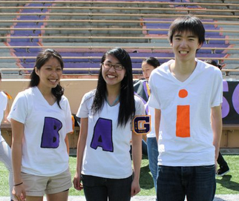
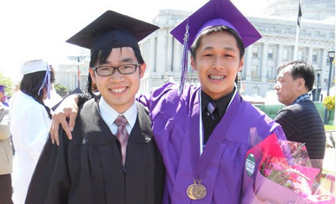
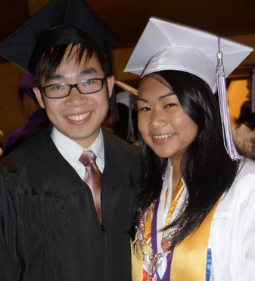
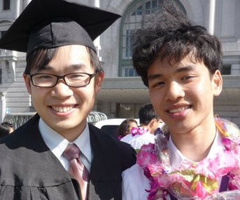





THANK YOU!
The key to success in college and beyond has more to do with what students do with their time during college than where they choose to attend. Students' motivation, ambition and desire to learn have a
much stronger effect on their subsequent success
-Martha O’connell, executive director of CTCL

Slide 65

Questions

